Slide 1
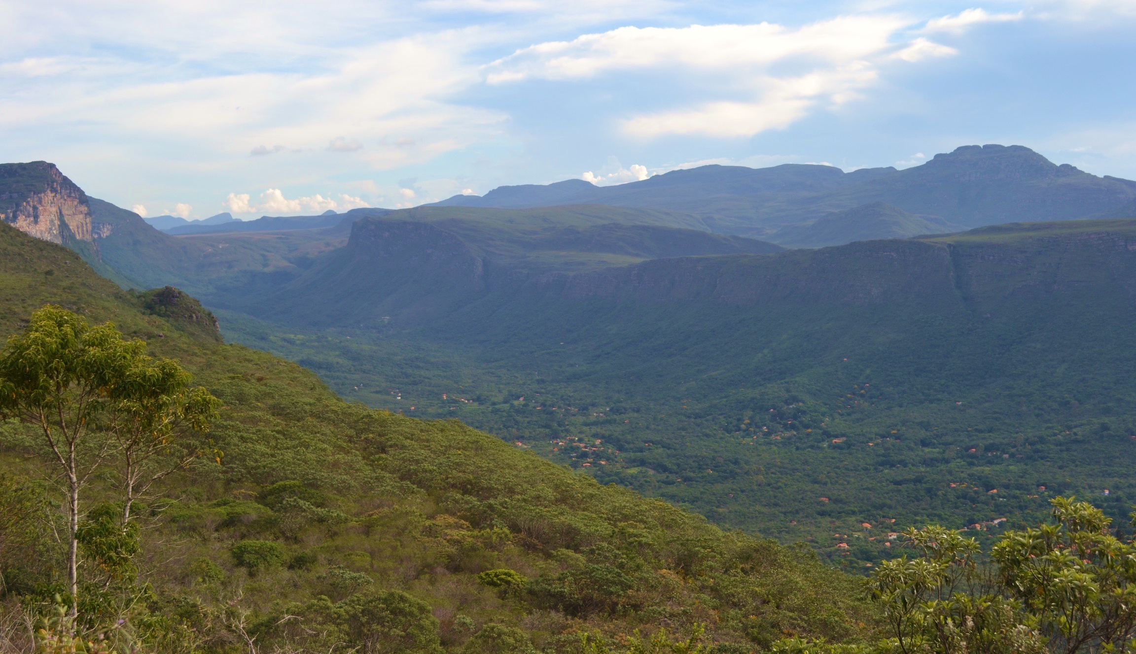
USING BIOTAPHY TO INVESTIGATE PLANT COMMUNITIES IN OCBILs
Maria Beatriz Cortez, Ryan Folk, CJ Grady, Jonathan Spoelhof, Stephen Smith, Douglas Soltis and Pamela Soltis.

Slide 2
The Ocbil theory, Hopper (2009)
Reduced dispersibility, increased endemism and common rarity;
Accentuated persistence-old lineages and old individuals;
Retention of heterozygosity or “The James Effect”;
Prolonged speciation at the margins;
Adaptations to saline soils;
Nutritional and other biological specialization;
Special vulnerability (e.g. to soil removal) and enhanced resilience (e.g. to fragmentation).

Slide 3
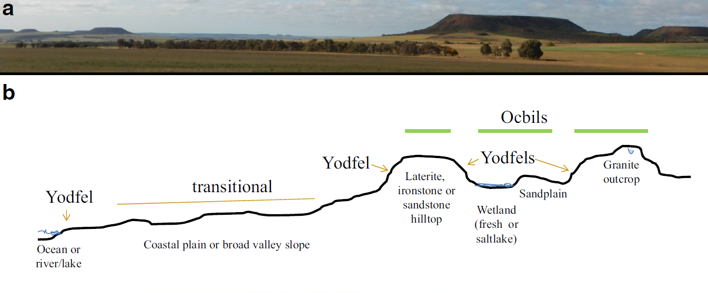
What do Ocbils look like?
Old, climatically stable infertile landscapes
Young, often disturbed, fertile landscapes
Hopper, Silveira and Fiedler (2016)

Slide 4
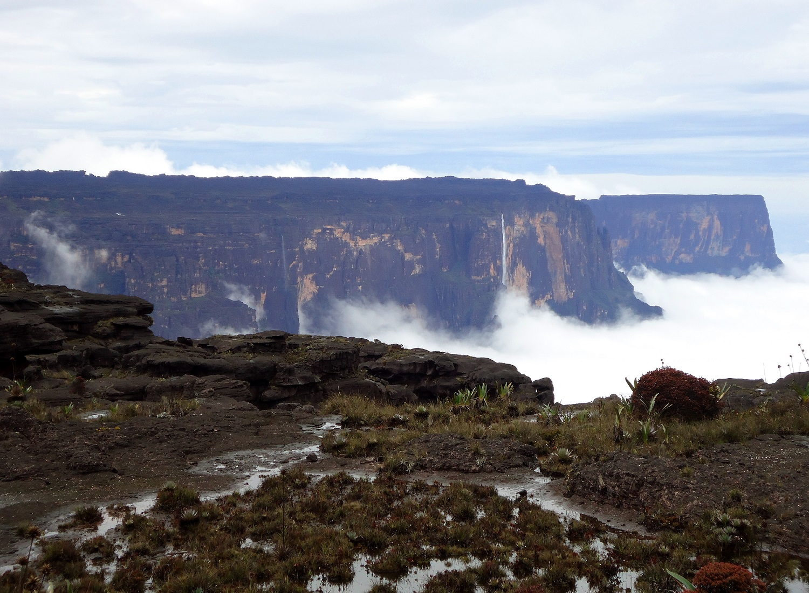
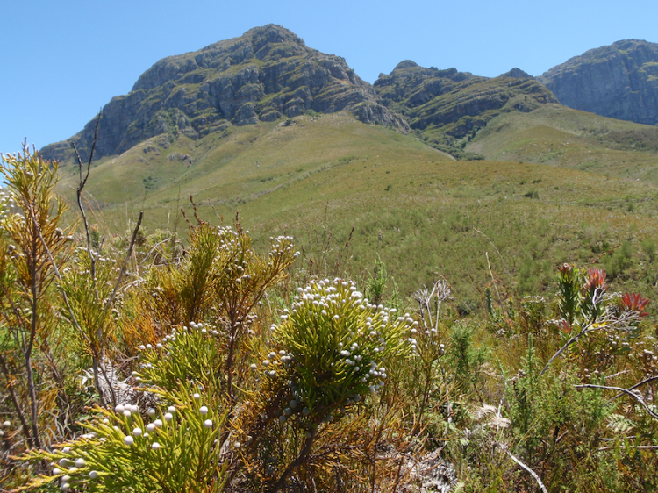
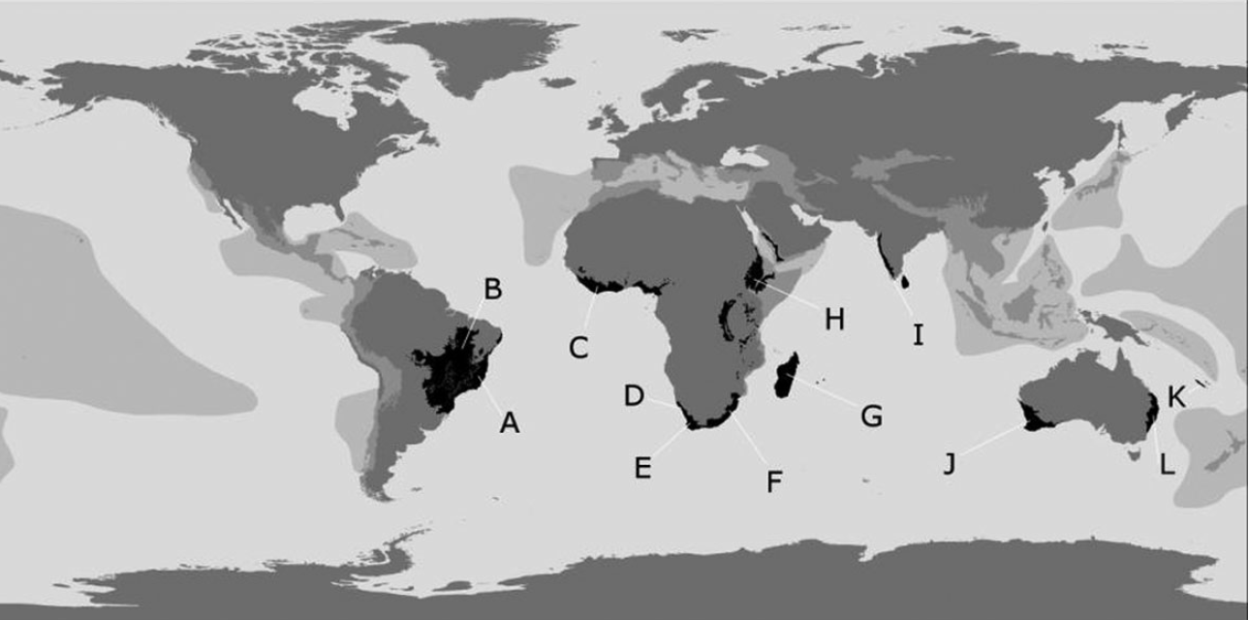
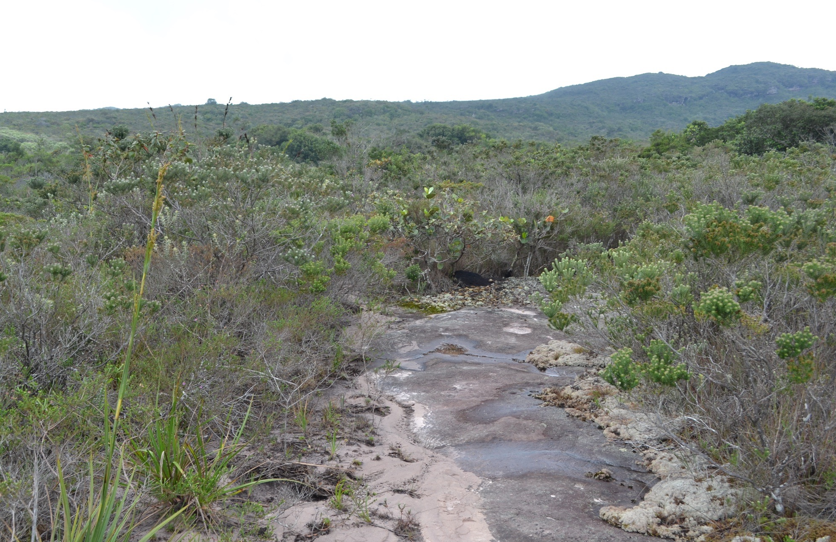
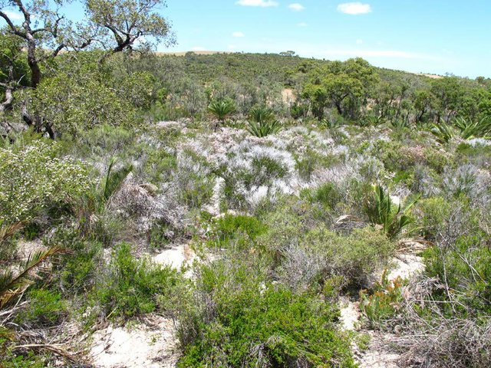
Where are Ocbils located?
Yuribia Vivas
Steven L. Chown
Pantepuis
Great Cape Floristic Region (GCFR)
Southwestern Australian Floristic Region (SWAFR)
Campo rupestre
Maria Cortez
Hans Lambers

Slide 5
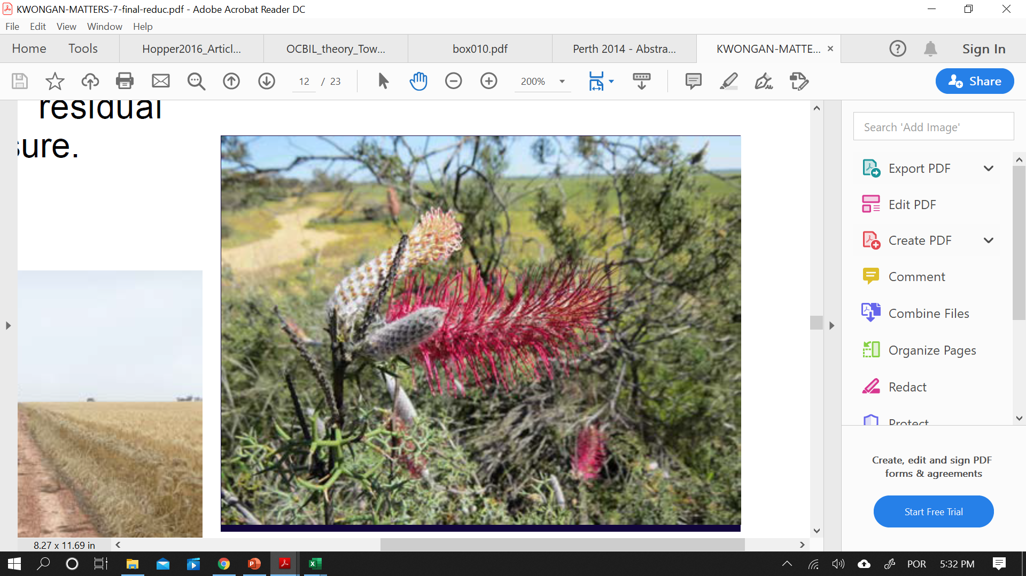
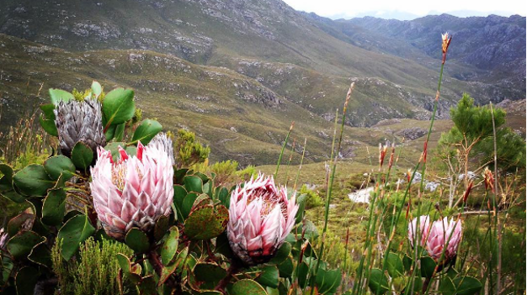
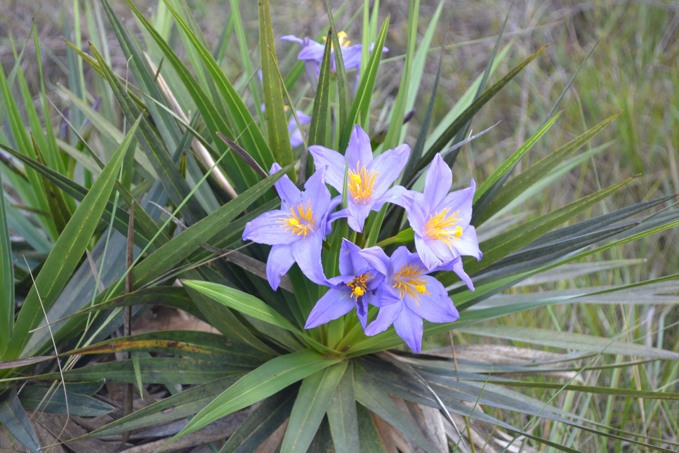
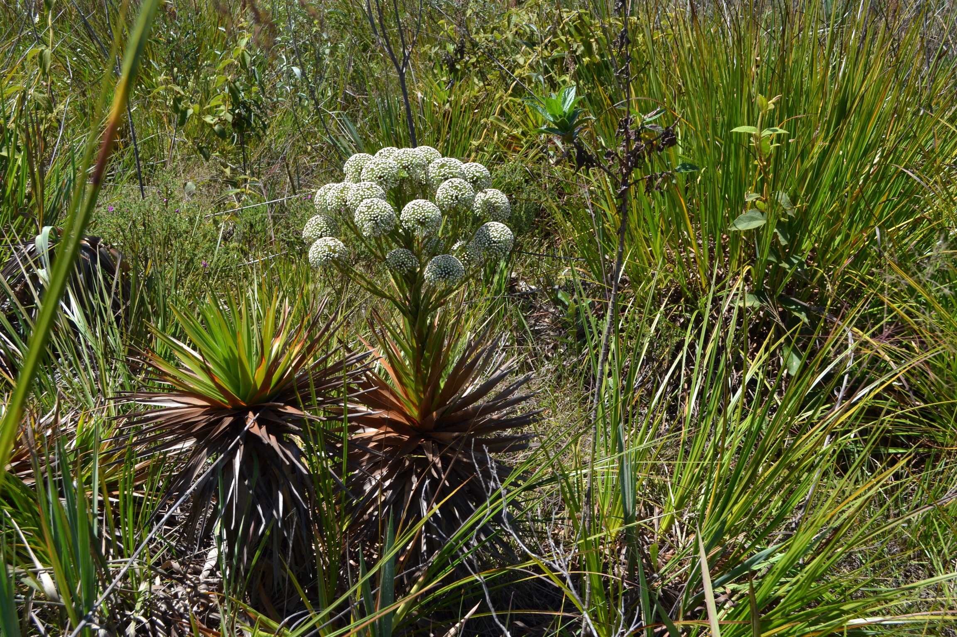
Characteristics of major Ocbils
Ken McNamara
stieviewondertours
Maria Cortez
PROTEACEAE
SWAFR
PROTEACEAE
GCFR
VELLOZIACEAE
Campo rupestre
Flora dominated by shrubs and grasses and unusual families
High species diversity
High levels of endemism
Many microhabitats
Maria Cortez
ERIOCAULACEAE
Campo rupestre

Slide 6
Objectives and Approach
Test part of the second premise of the Ocbil theory: Accentuated persistence-old lineages
Geographical framework: South America (campos rupestres), Sub-Saharan Africa (GCFR) and Australia (SWAFR).
Identify the past and current environmental characteristics of the geographic regions selected to test whether ancient lineages are more common in the Ocbils found in these regions.
Our approach offers a quantitative framework to test the Ocbil theory.

Slide 7



Retrieving phylogenetic and spatial data
1
Dated seed plant phylogeny by Smith & Brown (2018) → only accepted names.
2
3
Occurrence data
cleaning steps
Unique
Sufficient
Correctly assigned
Bounding box →
South America
Sub-Saharan Africa
Australia
bad GBIF or iDigBio flags
removed locality points outside the distribution predicted by POW

Slide 8
Retrieving environmental data
WorldClim
Bioclim 1 (Annual Mean Temperature),
Bioclim 7 (Temperature Annual Range),
Bioclim 12 (Annual Precipitation)
Bioclim 17 (Precipitation of Driest Quarter)
Paleoclim
Calculated pairwise distance between 6 time frames for temperature and precipitation data
gtopo30
Elevation
Soil Grids
Sand content
Soil organic carbon content
Soil pH in water
Coarse fragment volumetric.

Slide 9
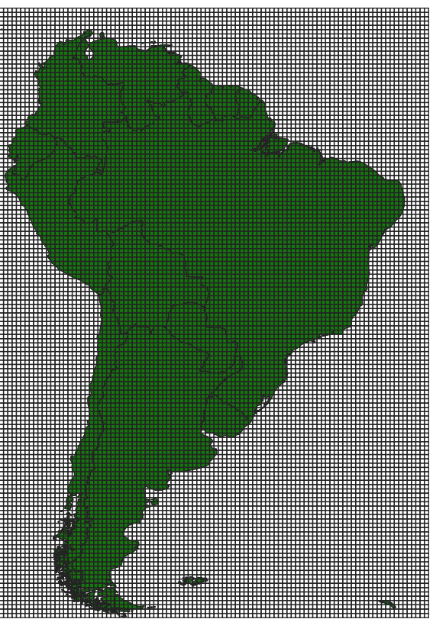

Integrating spatial, phylogenetic, and environmental data
Occurrence records used to produce spatial distribution models (SDM) in Maxent.
SDMs for taxa occurring at the community level were overlaid (PAM).
A subtree for each community was trimmed from the more comprehensive phylogeny.
community
0.5
0.5
PAM
SDM
South America’s bounding box organized into an equal sized cell grid

Slide 10
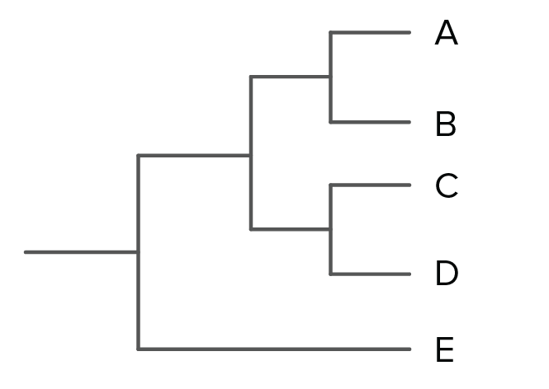
Integrating spatial, phylogenetic, and environmental data
Mean Node Height (MNH): corresponds to the mean age of all the internal nodes of a tree.
Mean Tip Age (Length) (MTL): corresponds to the mean age of all immediate parent nodes of each tip of the tree.
h
g
i
f
2mya
MNH f= 7mya g= 4mya h= 2mya i= 2mya
7+4+2+2 = 7.5mya
2
MTL h= 2mya i= 2mya
2+2 = 2mya
2

Slide 11
Ancient communities in South America
Dry, cold and elevated areas
Alkaline soils containing an elevated volume of coarse fragments
Cortez et al. (2020)

Slide 12
Community age across South America (MTL)
Central
South and Central regions of the Andes – known for being formed before the Northern region.
Intermediate altitude areas are probably older than mountain tops.
South
Cortez et al. (2020)

Slide 13
Looking closely at the Ocbils investigated: campos rupestres
Cortez et al. (2020)

Slide 14
Methodology biases: data
Occurrence data → incomplete, non comprehensive and subjected to biases; may influence results
Unequal sampling may lead to the exclusion of some areas that posses insufficient data to conduct the analyses.
Including other databases → important to amplify sampling
RAINBIO (Dauby et al., 2016),
SpeciesLink (http://www.splink.org.br/),
Atlas of Living Australia (ALA) (https://www.ala.org.au/).

Slide 15
Methodology biases: scale
Delimitation of Ocbils is difficult and imprecise; remote sensing should improve it, allowing for more accurate and fine scale comparisons (Schut et al., 2014).
Studies conducted at smaller scales identified an accrual of ancient lineages in quarzitic soils in the campos rupestres (Zappi et al., 2017).
Using finer scales may also generate problems with the analyses like artificially empty cells (Linder, 2001)

Slide 16
Conclusion
Both metrics used in this study (MNH e MTL) indicate community age is influenced by a combination of multiple environmental variables.
Although we could not observe a clear association between ancient lineages and Ocbils, we understand our methodological approach (large scale) may have influenced this result.
For future studies, we suggest inclusion of more databases and a finer scale approach.

Slide 17
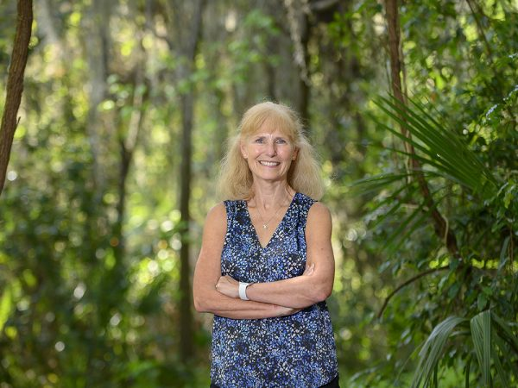













Acknowledgements
Pamela Soltis
Douglas Soltis
Ryan Folk
CJ Grady
Aimee Stewart
Jon Spoelhoff
Stephen
Smith
Soltis Lab
UF’s Biology Department
Biotaphy

